Slide 1
Wireshark: A Network Analysis Tool

Slide 2
What is Wireshark?
A free and open-source network protocol analyzer.
Used to capture and analyze network traffic in real time.

Slide 3
Key Features
Real-time packet capture
Rich protocol analysis
Intuitive graphical interface
Filters for specific traffic
Export packet data for offline analysis

Slide 4
Why Use Wireshark?
Debugging Network Issues:
  Identify bottlenecks or errors in network traffic.
Security Analysis:
  Detect potential malicious activity or intrusions.
Educational Purposes:
  Learn how protocols and networks operate.
Performance Monitoring:
  Ensure optimal performance of networks.

Slide 5
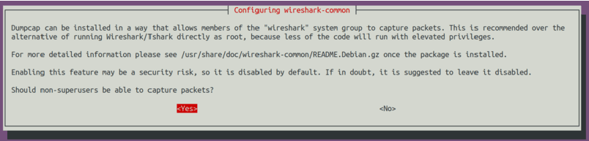
Installing Wireshark on Ubuntu
Update System Packages:
  sudo apt update
Install Wireshark:
  sudo apt install wireshark
Allow Non-Super Users to Capture Packets:

Slide 6
Add current user to the WireShark group
  To allow a non-root user to capture packets, add the user to the wireshark group
  sudo usermod -aG wireshark $(whoami)
Restart Your Session:
  Log out and log back in or restart your system.

Slide 7
Launching Wireshark
Open a terminal or application menu.
Run the command:
  wireshark
Start capturing packets by selecting an interface and clicking Start.

Slide 8
Understanding the Wireshark Interface
Key Components:
  Menu Bar: Access all functionalities.
  Toolbar: Start/stop capturing, apply filters.
  Packet List Pane: Displays captured packets.
  Packet Details Pane: Shows detailed information about the selected packet.
  Packet Bytes Pane: Hexadecimal view of the packet data.

Slide 9
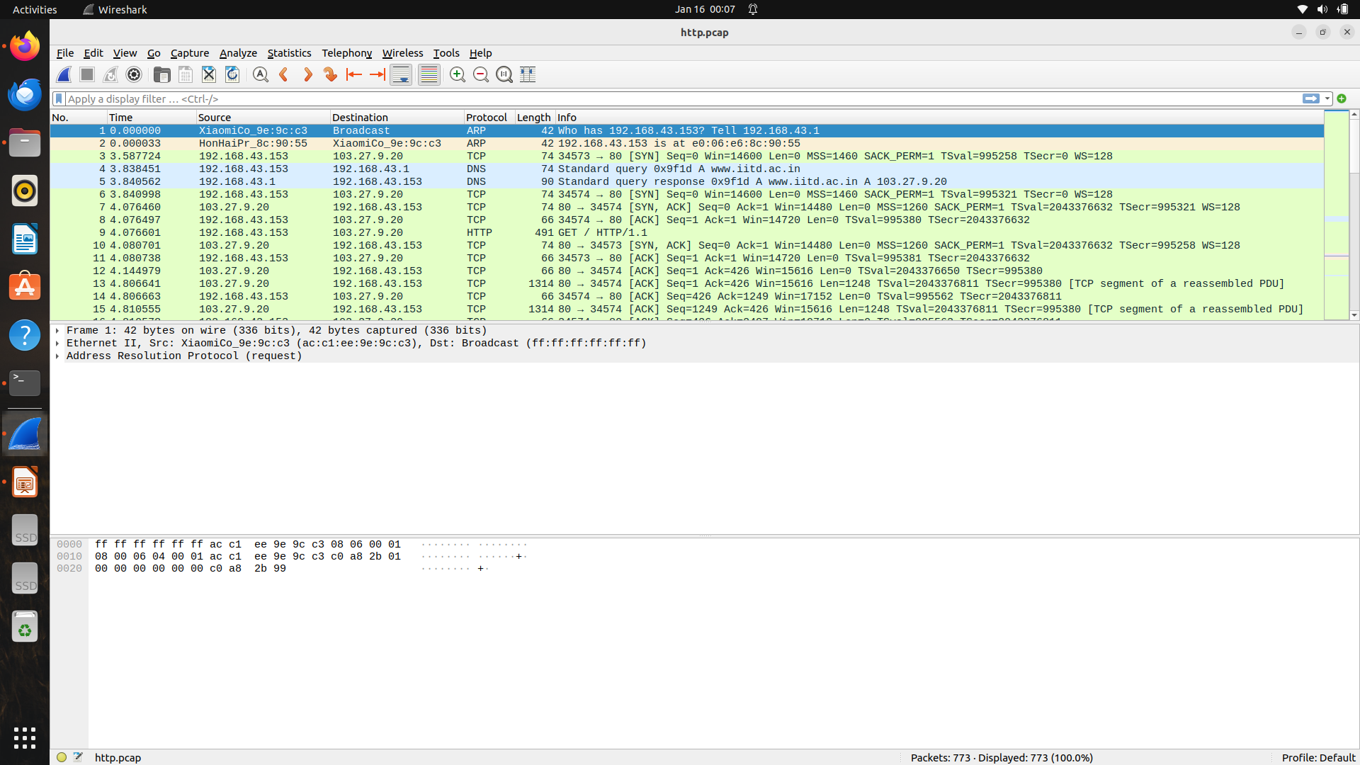

Slide 10
Analyzing PCAP Files with Wireshark
What is a PCAP File?
  A file format used to save captured network traffic.

Slide 11
Steps to Analyze:
  Open PCAP File:
    Go to File > Open and select the .pcap file.
  Apply Filters:
    Use display filters to narrow down traffic (e.g., http, tcp.port == 80 ).
  Inspect Packets:
    Click on packets to view their details.
  Export Data:
    Export specific packets via File > Export Objects.

Slide 12
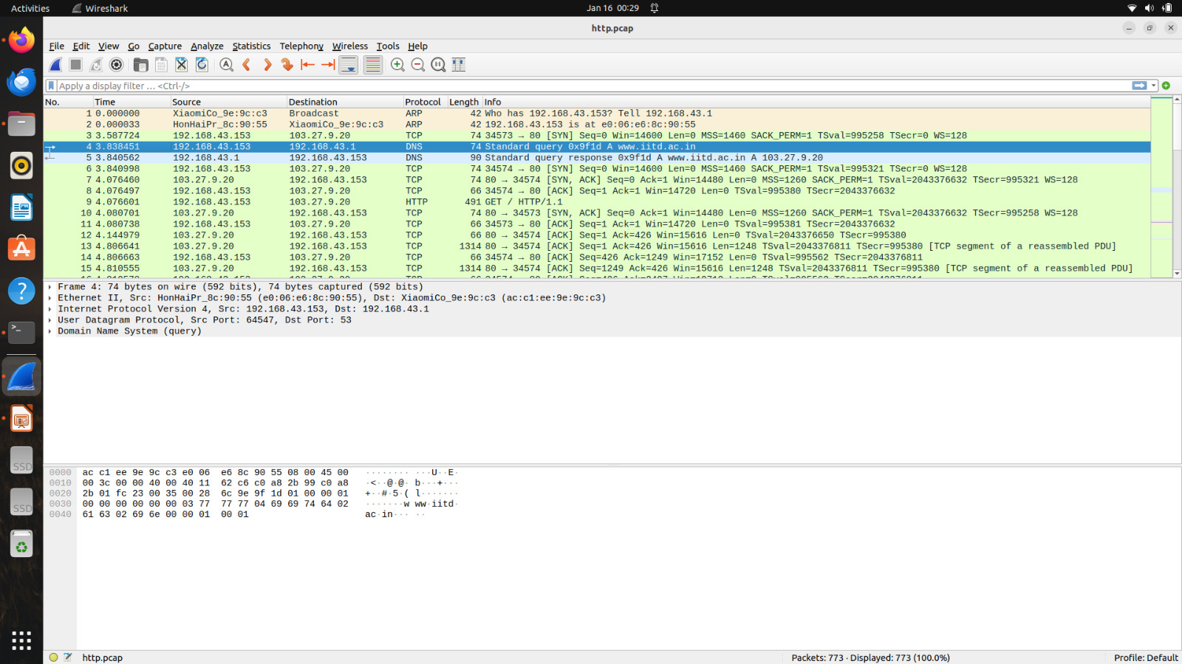
This is an ARP request, asking for the MAC address of 192.168.43.153

Slide 13
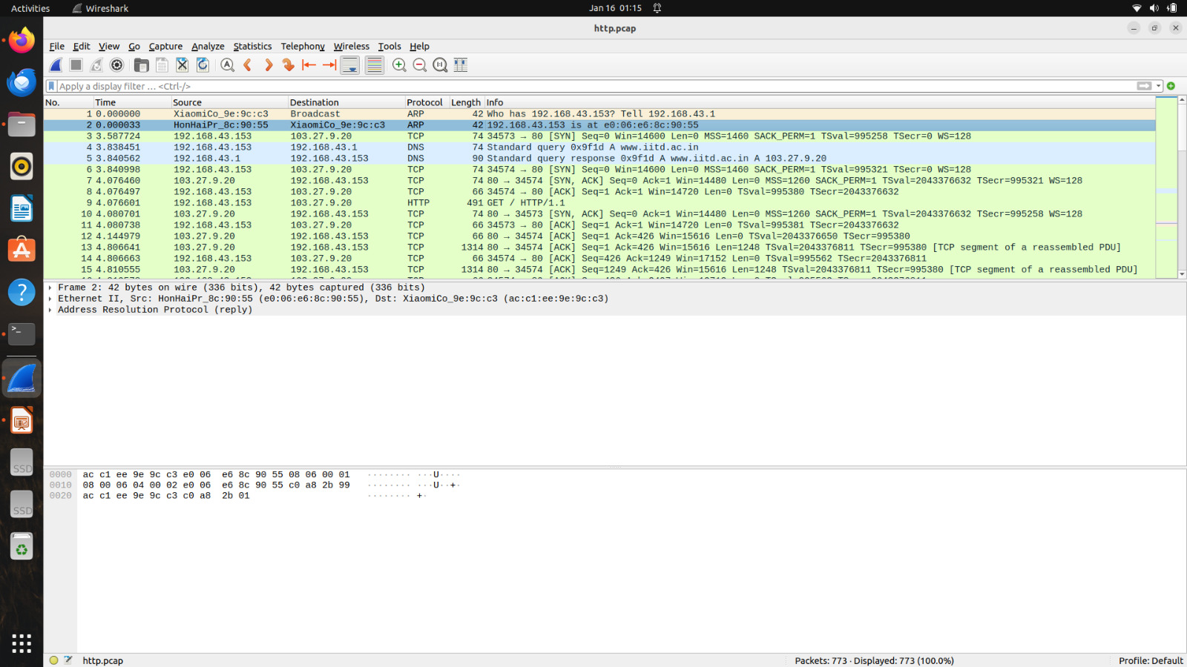
This is an ARP reply, providing the MAC address of 192.168.43.153

Slide 14
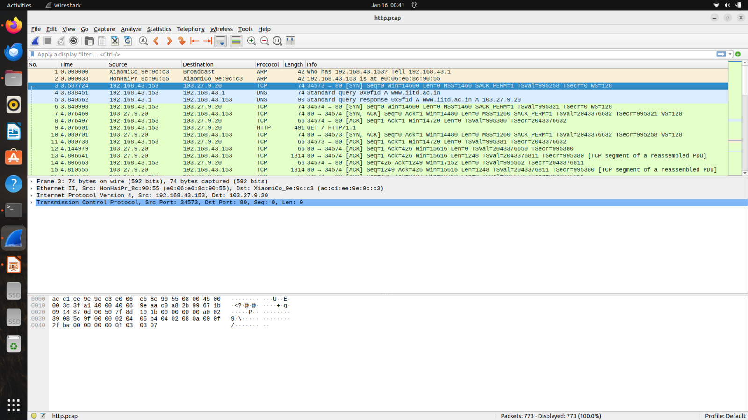
SYN (Synchronize) packet.
This is the start of a TCP handshake, initiating a connection.
[SYN]: Indicates this is a SYN packet.
Seq=0: Initial sequence number sent by the client.
Win=64240: TCP window size, indicating how much data the sender is willing to accept.
Len=0: No payload in this packet (handshake packets typically do not contain data).
MSS=1460: Maximum Segment Size, the largest amount of data the sender can handle in a single TCP segment.
SACK_PERM=1: Indicates support for Selective Acknowledgments.
TSval and TSecr: TCP timestamp options, used for round-trip time calculation.
WS=128: TCP Window Scaling factor.

Slide 15
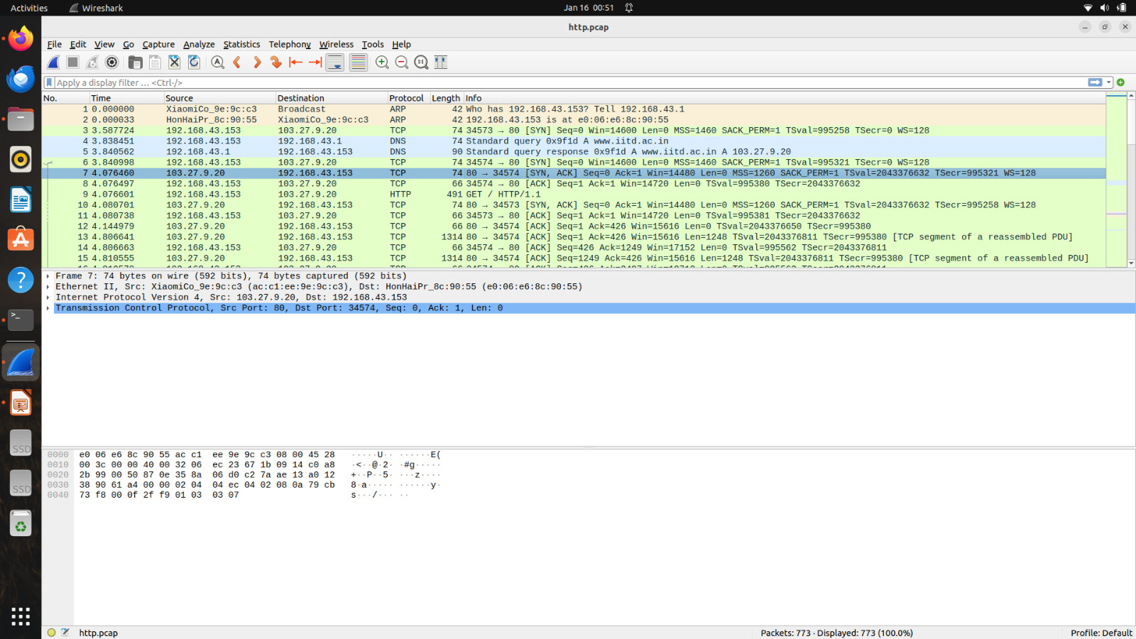
SYN-ACK (Synchronize-Acknowledge) packet.
Server responds to the TCP handshake request.

Slide 16
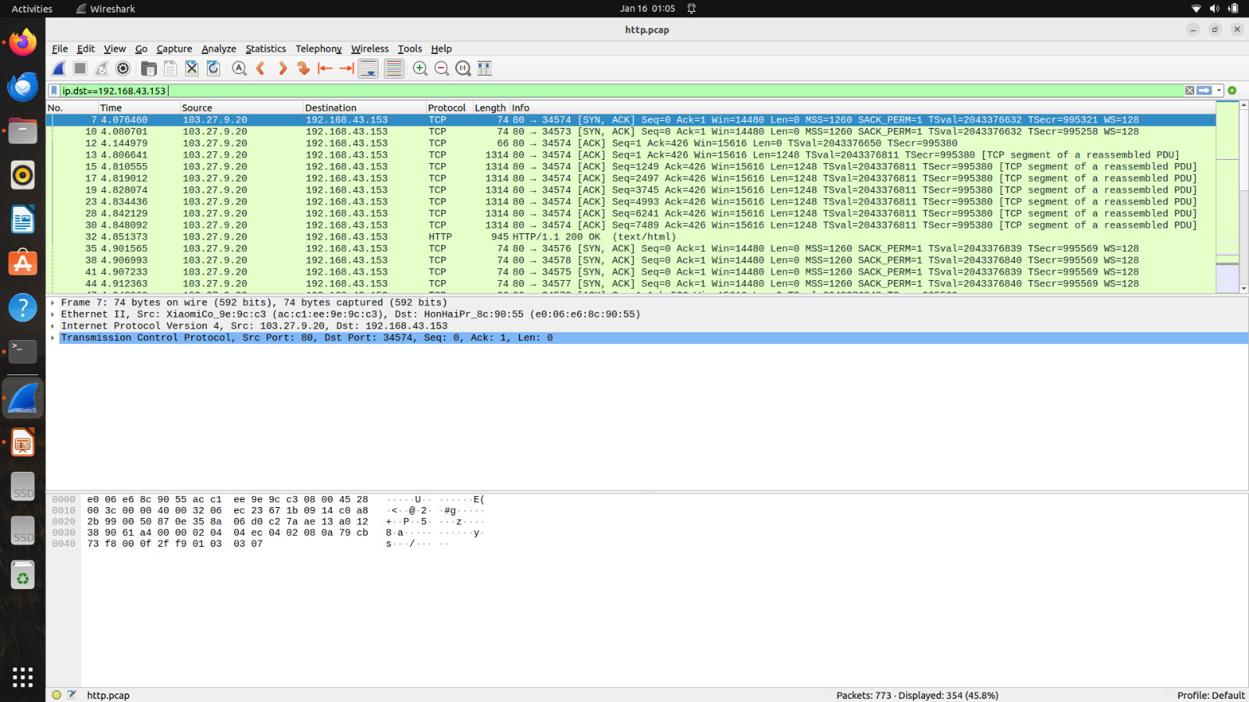
Add a display filter to only display packets related to the IP address 192.168.43.153.
Click in the display filter toolbar and type
ip.dst== 192.168.43.153

Slide 17
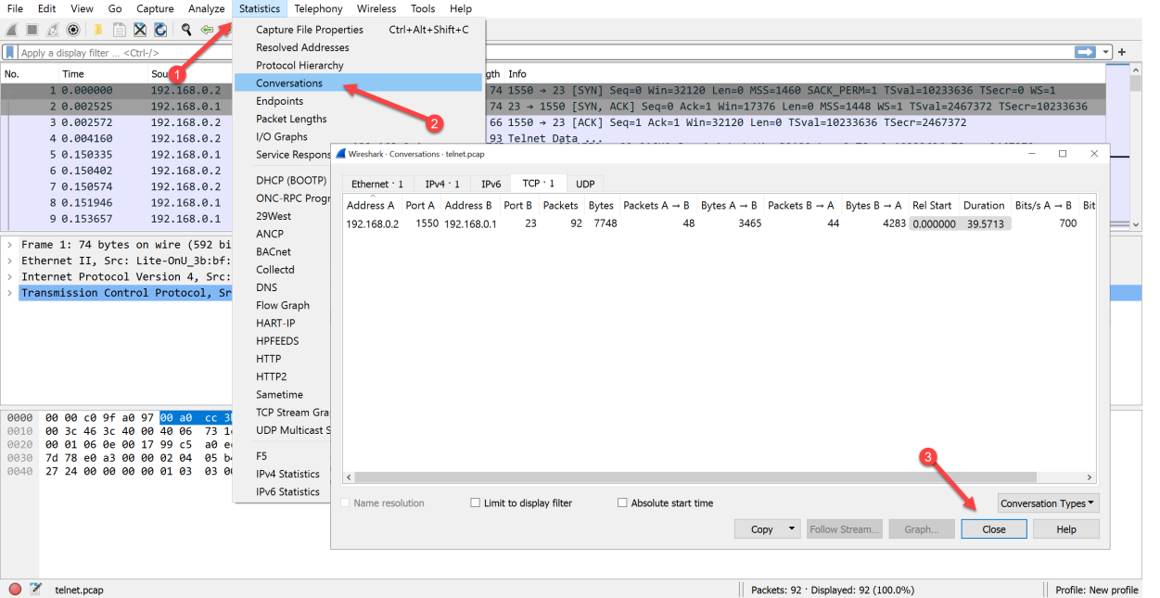
To view the conversations between hosts

Slide 18
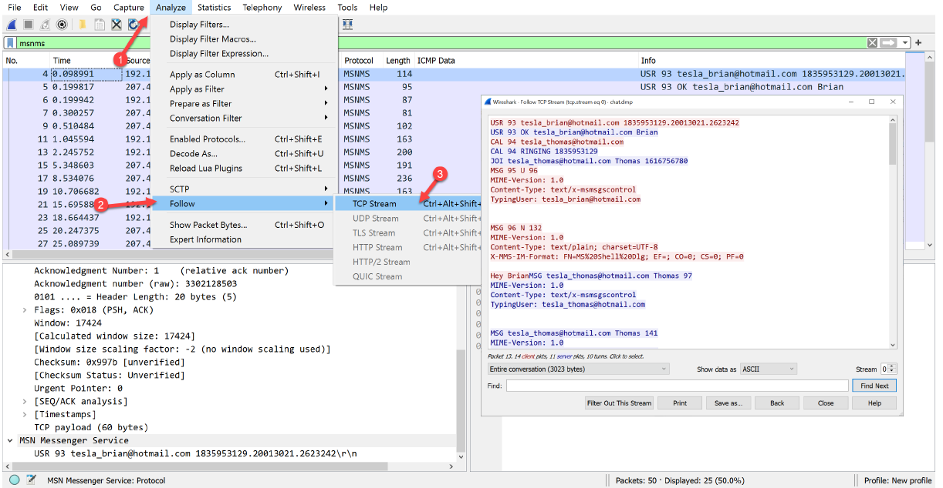
Follow the tcp stream, to view the conversation

Slide 19
Basic Wireshark Display Filters
IP Address Filters
  ip.addr == 192.168.1.1
  ip.src == 192.168.1.1
  ip.dst == 192.168.1.1
Protocol-Based Filters
  tcp
  udp
  http

Slide 20
Basic Wireshark Display Filters
Port Number Filters
  tcp.port == 80
  tcp.srcport == 443
  tcp.dstport == 21
  udp.port == 53
HTTP Filters
  http.request
  http.response
  http.request.method == "GET"
  http.response.code == 200

Slide 21
Basic Wireshark Display Filters
DNS Filters
  dns.qry.name == "www.google.com"
  dns.flags.response == 1
Packet Content Filters
  frame contains "pdf"
  frame contains "GET"

Slide 22
Basic Wireshark Display Filters
TCP Flags Filters
  tcp.flags.syn == 1
  tcp.flags.ack == 1
  tcp.flags.fin == 1
Error / Retransmission Filters
  tcp.analysis.retransmission
  icmp.type == 3

Slide 23
Basic Wireshark Display Filters
Combine Filters (AND / OR)
  tcp && ip.addr == 192.168.1.1
  http || dns

